Slide 1
UFBB 2022
背景：UFBB 2022.9 提纲，20min presentation, 5min Q&A
UFBB发言提纲: Delivery of Premium Services with Multi-technology Network Slicing
Slides:
1p Background/Scenario: VR/Education - computing? Industry PON? Metaverse
1p Premium Service Use case - 入云专线OSP/品质家宽;
1p Challenges for Premium Service - F5G 六边形，summary
1-2p Key supporting solution - Hardware (OSU, FTTR, 50G PON...) Software (OSP, Slicing) Network technologies to support these use cases
Sub-1G OSU
FTTR
50G PON
800G OTN
Deterministic networking
End to end slicing, e2e mgmt and ctrl
1-2p (optional) Hardware
1p Slicing enabling (F5G E2E mgmt)
1p OTN slicing - IETF ?
1p packet slicing - IETF
1p PON slicing - G.sup74, BBF MRT;
1p slice realization - ACTN (management system)
1p slice realization - OSP (overlay+underlay)
1p Best practice / commercial solution; - OFC PoC/ACTN ZSM PoC
1p summary/Plan: F5G-Advanced, OCN, ADN, ...

Slide 2
Supporting Solutions
Open Interface
Slicing
Automation
E2E Mgmt & Ctrl
PON
OTN
Cloud
50G PON
FTTR
800G OTN
Sub 1G OSU
DCI
Apps
Computing
Next gen OCN

Slide 3
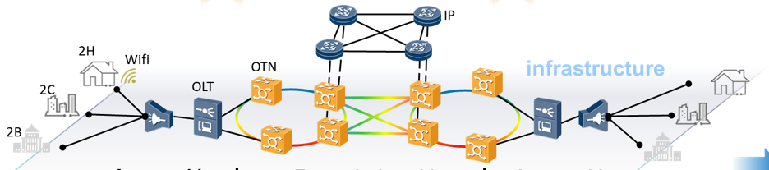
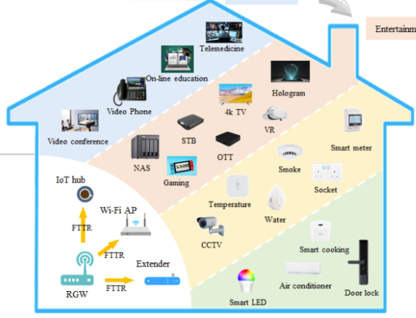
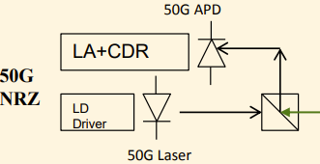
Network Technologies Supporting Premium Services
Monitor
Orchestration
Analytics
E2E Service Orchestrator
BoD
Network Slicing
Network Automation
Deterministic Networking
AN Controller
AggN Controller
DC Controller
IP SBI
Cloud
CPN
PON
Aggregation Network
DCI
Computing
800G+ OTN
Sub-1G OSU
FTTR
50G PON
Reach (e2e: Fiber to the room, optical to cloud)
Bandwidth (Larger bandwidth single fiber)
Granularity (smaller granular optical payload, OSU)
Notes:
- Data plane to support premium services:
Reach (Fiber to the room, optical to cloud)
Bandwidth (Larger bandwidth single fiber)
Granularity (smaller OSU)

Slide 4

End-to-end Management & Control
Intent
Orchestration
E2E Service Orchestrator
CPN NBI
AN NBI
AggrN NBI
CN NBI
Management, Control
CPN Controller
AN Controller
AggN Controller
CN Controller
AN Controller
IP Controller
CPN SBI
AN SBI
IP SBI
CN SBI
E
-
CPE
FTTR
CPN
-
A
OTN SBI
E
-
CPE
RG
ONU
Core
IP/Eth AggN
Core PE
Network
WG
ONU
OLT
Control Plane & Protocols
CE
ONU
AggN
Edge
IE
ONU
DC GW
Cloud/
OTN
'
Local DC
CE
OTN-CPE
Edge
OTN
XC
Customer Premises Network
Access Network
Aggregation Network
Core Network

Slide 5
Slicing-enabled applications

Slide 6
Differentiated Services with End-to-end Slicing
Intent
E2E Slice Orchestrator
Intent-oriented Slice Requests
Standard, open interfaces to ensure interoperability across different providers
Multi-layer, multi-domain for scalability
CPN NBI
AN NBI
IP NBI
OTN NBI
CN NBI
CPN Slice
Controller
AN Slice
Controller
IP Slice Controller
CN Controller
OTN Slice Controller
Best effort
AN Slice
IP Slice
DC Slice
High Quality
OTN Slice
Premium
L0 Slice
IP SBI
Best effort
High Quality
Cloud
Premium
CPN
PON
Aggregation Network

Slide 7





Open, Standard Interfaces for E2E Network Slicing
Access
IP/Transport
DC
FAN Sharing and Data Models (WT-370, 386i2)
TEAS WG
ACTN Framework
Network Slicing
CCAMP WG
OTN Slicing
SG15?
MEF LSO Architecture
Network slicing for 5G based on MEF 3.0 standards
F5G E2E Management & Control

Slide 8
E2E Mgmt & Ctrl
Orchestration
CNC
E2E Mgmt & Ctrl
Close loop automation
MDSC-H
MDSC-L
PON Ctrl
OTN / IP
DC Ctrl
OTN / IP
PNC
PNC
PON
IP
Cloud
IETF ACTN
OTN

Slide 9
Open interface for network slicing
BBF
IETF
ITU
OTN slicing (tech specific)
IP network slicing
ACTN TE models
PCE
GMPLS
PON
ETSI F5G
F5G framework

